Slide 1
Clustering in Natural Language Processing & Text Mining
CpE 6330 Project Presentation
Stuart Miller
Master’s Student in Computer Engineering

Slide 2

Introduction
IEEE Xplore provides a developer API
176 Journals, Magazines, and Transactional Collections
Countless more conference and workshop proceedings

Slide 3
Questions/Goals
How similar are papers published in journals?
Can papers be neatly clustered by subject matter?
Do Journals and Transactions vary more or less than Conference and Workshop Proceedings?
Is this kind of clustering a useful tool for researchers?

Slide 4
Introduction
Use Abstracts
Assume representative of paper in general
More manageable
About 200 words each
The Internet of Things (IoT) shall be able to incorporate transparently and seamlessly a large number of different and heterogeneous end systems, while providing open access to selected subsets of data for the development of a plethora of digital services. Building a general architecture for the IoT is hence a very complex task, mainly because of the extremely large variety of devices, link layer technologies, and services that may be involved in such a system. In this paper, we focus specifically to an urban IoT system that, while still being quite a broad category, are characterized by their specific application domain. Urban IoTs, in fact, are designed to support the Smart City vision, which aims at exploiting the most advanced communication technologies to support added-value services for the administration of the city and for the citizens. This paper hence provides a comprehensive survey of the enabling technologies, protocols, and architecture for an urban IoT. Furthermore, the paper will present and discuss the technical solutions and best-practice guidelines adopted in the Padova Smart City project, a proof-of-concept deployment of an IoT island in the city of Padova, Italy, performed in collaboration with the city municipality.
A. Zanella, N. Bui, A. Castellani, L. Vangelista and M. Zorzi, "Internet of Things for Smart Cities," in IEEE Internet of Things Journal, vol. 1, no. 1, pp. 22-32, Feb. 2014. doi: 10.1109/JIOT.2014.2306328

Slide 5
Outline
Introduction
2018 Papers Analysis by LDA and LSA
Model Applicability
TF-IDF Analysis
Perplexity & Insights by Publication
Topic Accuracy
Conclusions and Ending Points

Slide 6
First Data Set
Consider all available papers with 2018 publishing dates
21,985 papers
30 MB of abstract and associated bookkeeping information

Slide 7
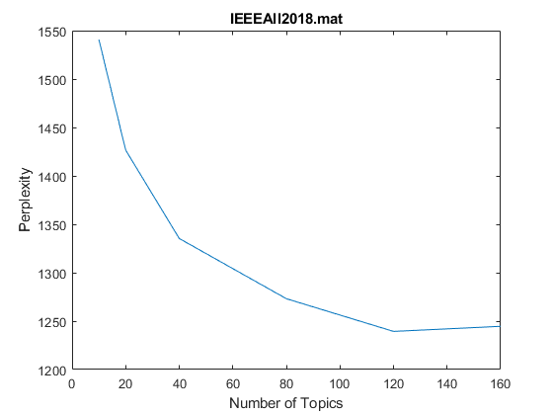
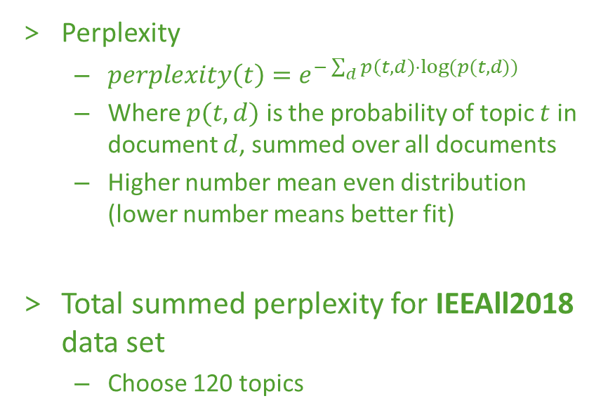
Latent Dirichlet Allocation Approach
Perplexity
$perplexity\left(t\right)=e^{−\sum_{d}{p\left(t,d\right)⋅log⁡(p(t,d))}}$
Where $p(t,d)$ is the probability of topic $t$ in document $d$, summed over all documents
Higher number mean even distribution (lower number means better fit)
Total summed perplexity for IEEAll2018 data set
Choose 120 topics

Slide 8
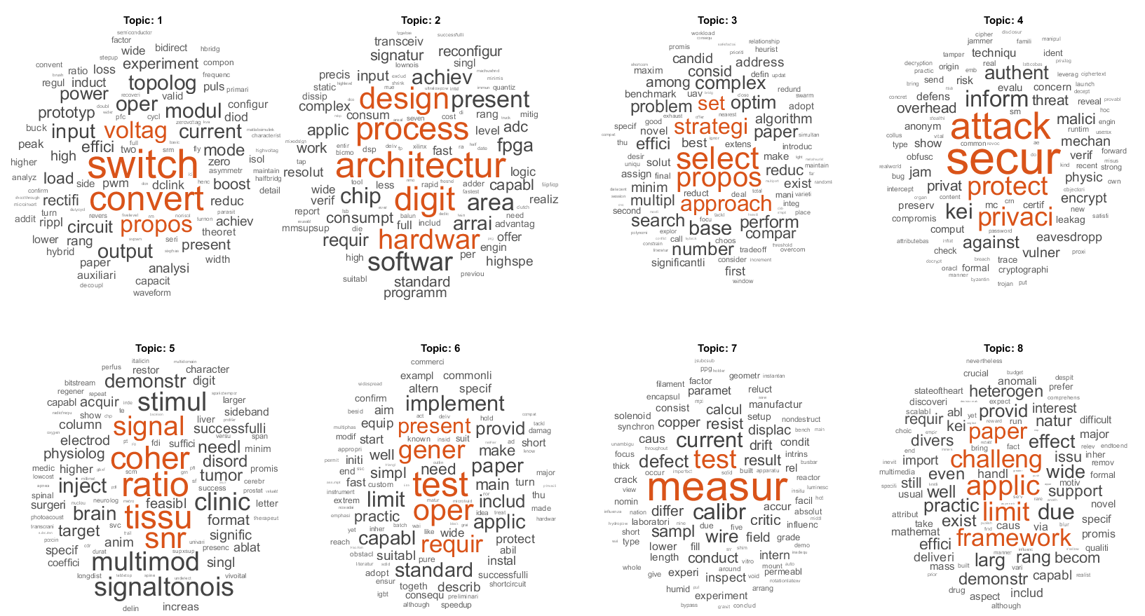
IEEEAll2018 First 8 Topics

Slide 9
IEEEAll2018 First 8 Topics (of 120)
Theme?
Theme?

Slide 10
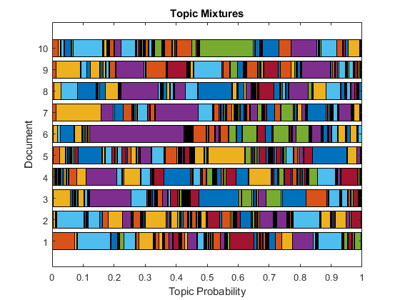
IEEEAll2018 First 10 Documents

Slide 11
Latent Semantic Analysis Approach
Choose 120 topics once again
Remember, fitness scores, not probability distributions

Slide 12
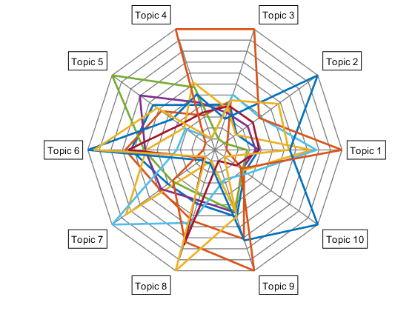
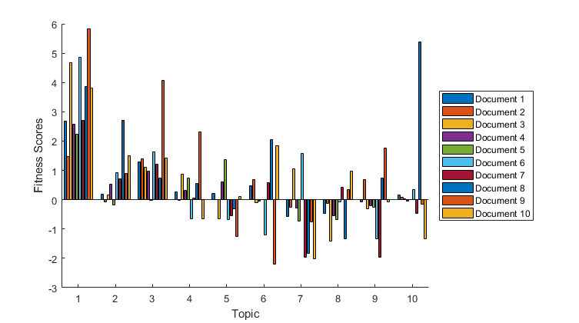
IEEEAll2018 First 10 Documents, First 10 Topics

Slide 13
IEEEAll2018 First 10 Documents, First 10 Topics

Slide 14
Overview
Pretty bad classification
Unusable number of topics
Topic assignments are messy
Re-run with fewer topics
20 topics
Sticking with this assignment for the remainder of the presentation

Slide 15
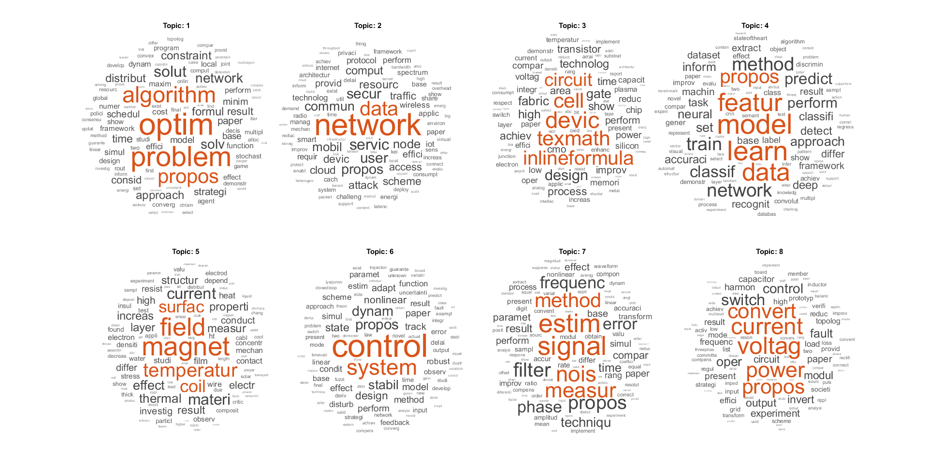
IEEEAll2018 First 8 Topics (of 20)

Slide 16
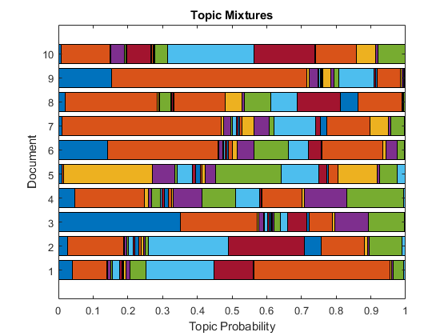
IEEEAll2018 First 10 Documents (20 topics)

Slide 17
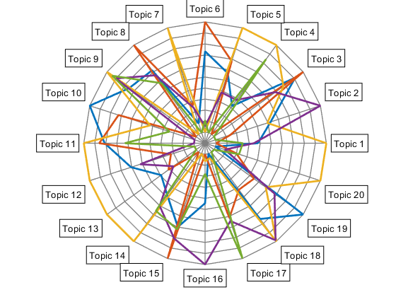
IEEEAll2018 First 10 Documents (20 of 20 topics)

Slide 18
Outline
Introduction
2018 Papers Analysis by LDA and LSA
Model Applicability
TF-IDF Analysis
Perplexity & Insights by Publication
Topic Accuracy
Conclusions and Ending Points

Slide 19
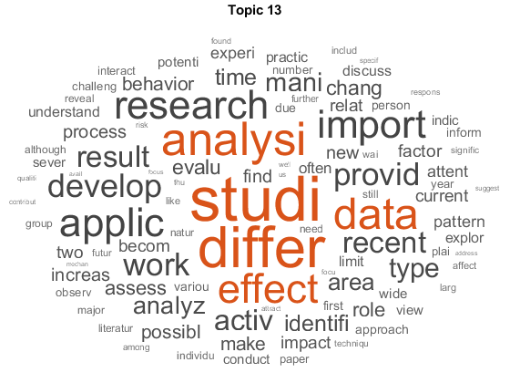
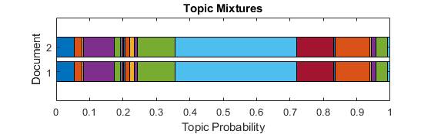
Model Applicability
Can we apply this model to any paper?
Dr. Wunsch’s Survey of clustering algorithms
Abstract
Data analysis plays an indispensable role for understanding various phenomena. Cluster analysis, primitive exploration with little or no prior knowledge, consists of research developed across a wide variety of communities. The diversity, on one hand, equips us with many tools. On the other hand, the profusion of options causes confusion. We survey clustering algorithms for data sets appearing in statistics, computer science, and machine learning, and illustrate their applications in some benchmark data sets, the traveling salesman problem, and bioinformatics, a new field attracting intensive efforts. Several tightly related topics, proximity measure, and cluster validation, are also discussed.
Rui Xu and D. Wunsch, "Survey of clustering algorithms," in IEEE Transactions on Neural Networks, vol. 16, no. 3, pp. 645-678, May 2005.

Slide 20
Question #1: How similar are journal papers?
Topic #1 - generic
Overall Topic Mixtures
Topic #3 - TeX syntax

Slide 21
Outline
Introduction
2018 Papers Analysis by LDA and LSA
Model Applicability
TF-IDF Analysis
Perplexity & Insights by Publication
Topic Accuracy
Conclusions and Ending Points

Slide 22
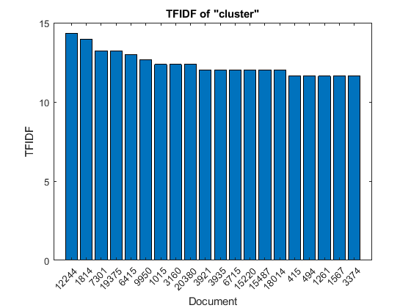
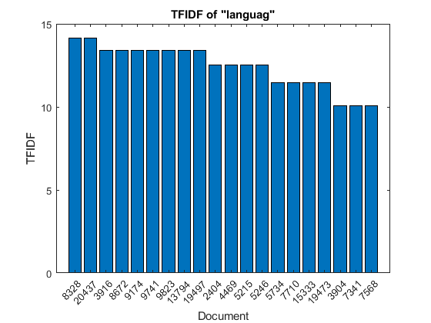
Term Frequency-Inverse Document Frequency Approach

Slide 23
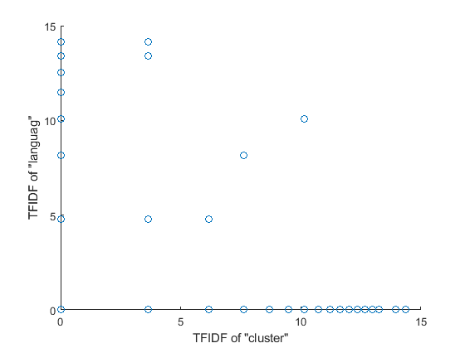
TF-IDF Results
Document 7568
On Pareto front
IEEE web search for “cluster language” returns this as well
We propose topic models for unsupervised cluster matching, which is the task of finding matching between clusters in different domains without correspondence information. For example, the proposed model finds correspondence between document clusters in English and German without alignment information, such as dictionaries and parallel sentences/documents. The proposed model assumes that documents in all languages have a common latent topic structure, and there are potentially infinite number of topic proportion vectors in a latent topic space that is shared by all languages. Each document is generated using one of the topic proportion vectors and language-specific word distributions. By inferring a topic proportion vector used for each document, we can allocate documents in different languages into common clusters, where each cluster is associated with a topic proportion vector. Documents assigned into the same cluster are considered to be matched. We develop an efficient inference procedure for the proposed model based on collapsed Gibbs sampling. The effectiveness of the proposed model is demonstrated with real data sets including multilingual corpora of Wikipedia and product reviews.
T. Iwata, T. Hirao and N. Ueda, "Topic Models for Unsupervised Cluster Matching," in IEEE Transactions on Knowledge and Data Engineering, vol. 30, no. 4, pp. 786-795, April 1 2018.

Slide 24

TFIDF Conclusions
Not useful
Nothing more than a basic internet search query
As per the algorithm’s design – meant to be fast and simple
Will omit for rest of this project

Slide 25
Outline
Introduction
2018 Papers Analysis by LDA and LSA
Model Applicability
TF-IDF Analysis
Perplexity & Insights by Publication
Topic Accuracy
Conclusions and Ending Points

Slide 26
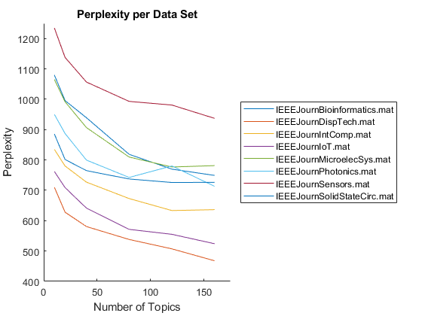
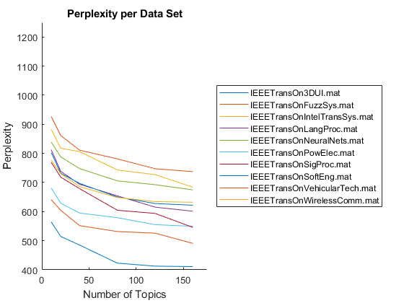
Perplexity for Journals and Transactions

Slide 27
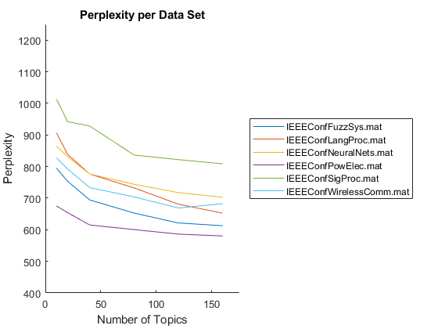
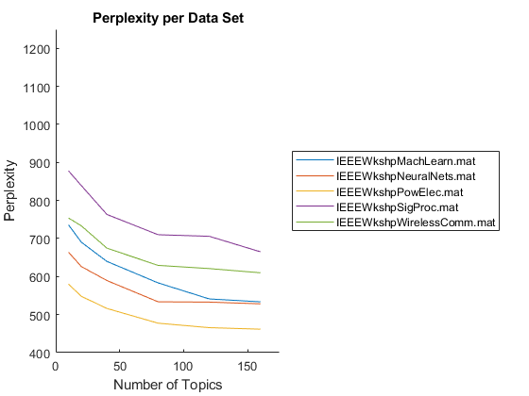
Perplexity for Journals and Transactions

Slide 28
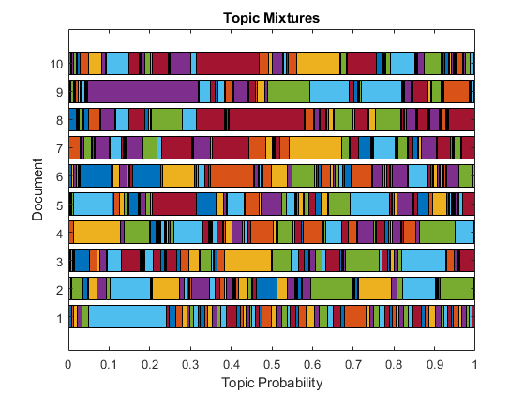
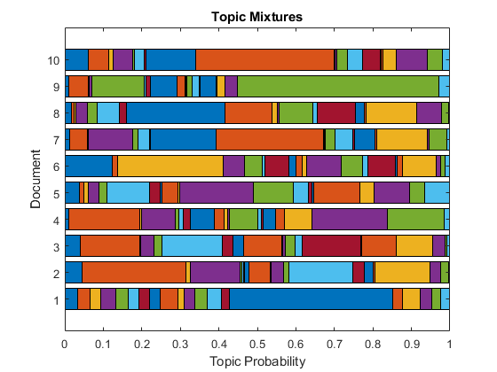
IEEE Sensors Journal Insights
Recommended 70 Topic LDA Model
Simplified 20 Topic LDA Model

Slide 29
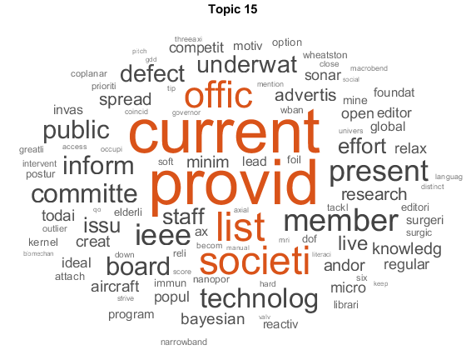
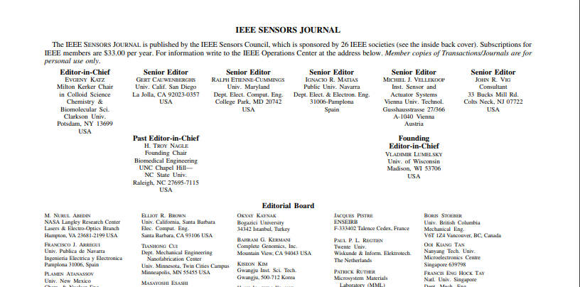
Topic 15 (Primary Topic of Docs 1, 14, 58, 90…)
Abstract
Provides a listing of current society officers.
"IEEE Sensors Journal publication information," in IEEE Sensors Journal, vol. 9, no. 11, pp. C2-C2, Nov. 2009.

Slide 30
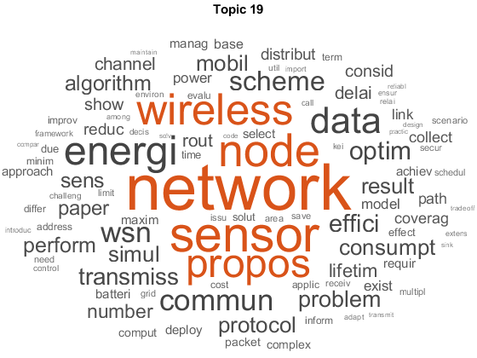
Topic 19 (Primary Topic of Doc 9)
Abstract
As an extension of wireless sensor network in underwater environment, underwater acoustic sensor networks (UASNs) have caused widespread concern of academia. In UASNs, the efficiency and reliability of data transmission are very challenging due to the complex underwater environment in variety of ocean applications, such as monitoring abnormal submarine oil pipelines. Motivated by the importance of energy consumption in many deployments of UASNs, we therefore propose an energy-efficient data transmission scheme in this paper, called energy-efficiency grid routing based on 3D cubes (EGRCs) in UASNs, considering the complex properties of underwater medium, such as 3D changing topology, high propagation delay, node mobility and density, as well as rotation mechanism of cluster-head nodes. First, the whole network model is regarded as a 3D cube from the grid point of view, and this 3D cube is divided into many small cubes, where a cube is seen as a cluster. In the 3D cube, all the sensor nodes are duty-cycled in the media access control layer. Second, in order to make energy efficient and extend network lifetime, the EGRC shapes an energy consumption model considering residual energy and location of sensor nodes to select the optimal cluster-heads. Moreover, the EGRC utilizes residual energy, locations, and end-to-end delay for searching for the next-hop node to maintain the reliability of data transmission. Simulation validations of the proposed algorithm are carried out to show the effectiveness of EGRC, which performs better than the representative algorithms in terms of energy efficiency, reliability, and end-to-end delay.
K. Wang, H. Gao, X. Xu, J. Jiang and D. Yue, "An Energy-Efficient Reliable Data Transmission Scheme for Complex Environmental Monitoring in Underwater Acoustic Sensor Networks," in IEEE Sensors Journal, vol. 16, no. 11, pp. 4051-4062, June1, 2016.

Slide 31
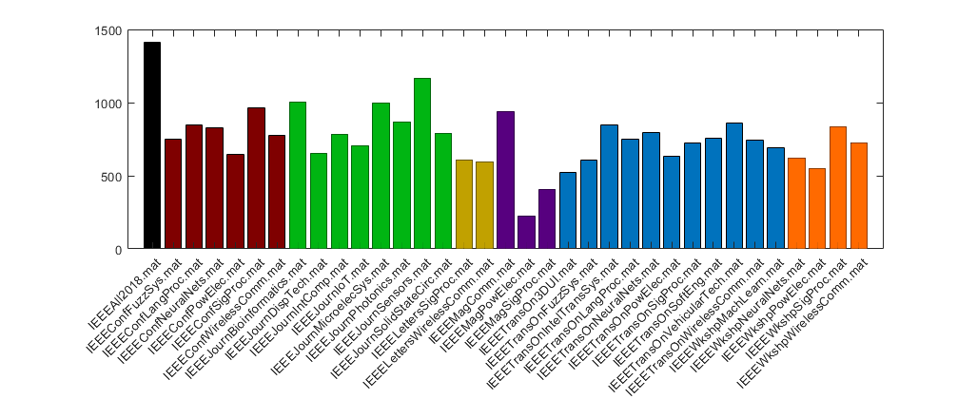
Perplexity by Journal

Slide 32
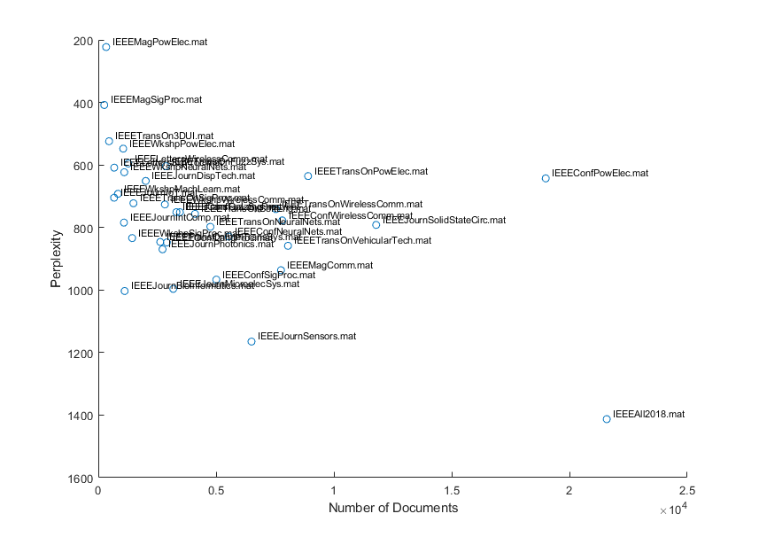
Data Set Size
Smaller data set ∝ lower perplexity
Magazines vs. All2018
Plenty of exceptions though
IEEE Conferences on Power Electronics

Slide 33
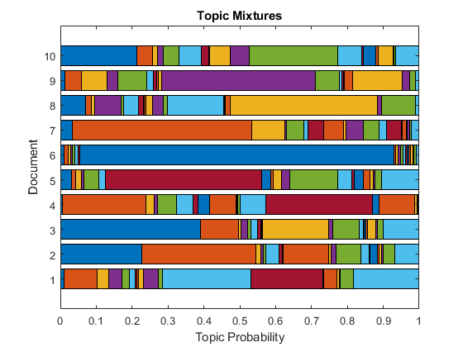
Data Set Size
Smaller data set ∝ lower perplexity
Magazines vs. All2018
Plenty of exceptions though
IEEE Conferences on Power Electronics

Slide 34
Question #2: Do Journals and Transactions vary more or less than Conference and Workshop Proceedings?
Not really
Journals are more varied
Subject matter is far more influential
Journals Transactions Conferences Workshops

Slide 35
Outline
Introduction
2018 Papers Analysis by LDA and LSA
Model Applicability
TF-IDF Analysis
Perplexity & Insights by Publication
Topic Accuracy
Conclusions and Ending Points

Slide 36
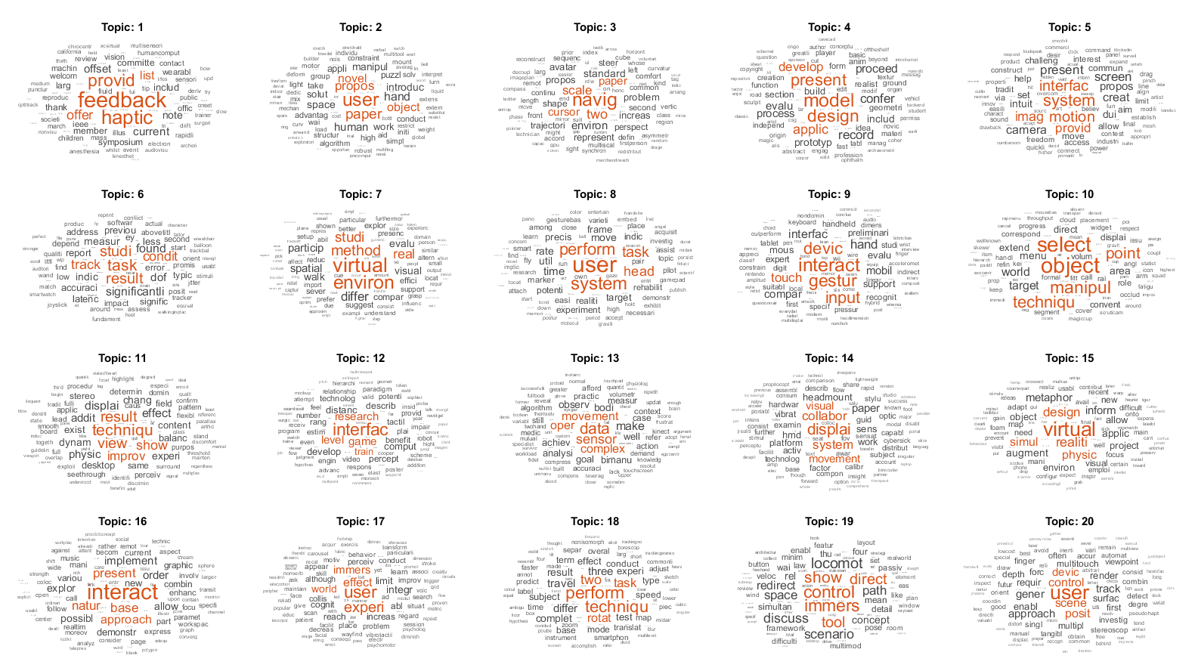
Highly Specific Topic:
IEEE Transactions on 3D User Interfaces

Slide 37
Highly Specific Topic:
IEEE Transactions on 3D User Interfaces

Slide 38
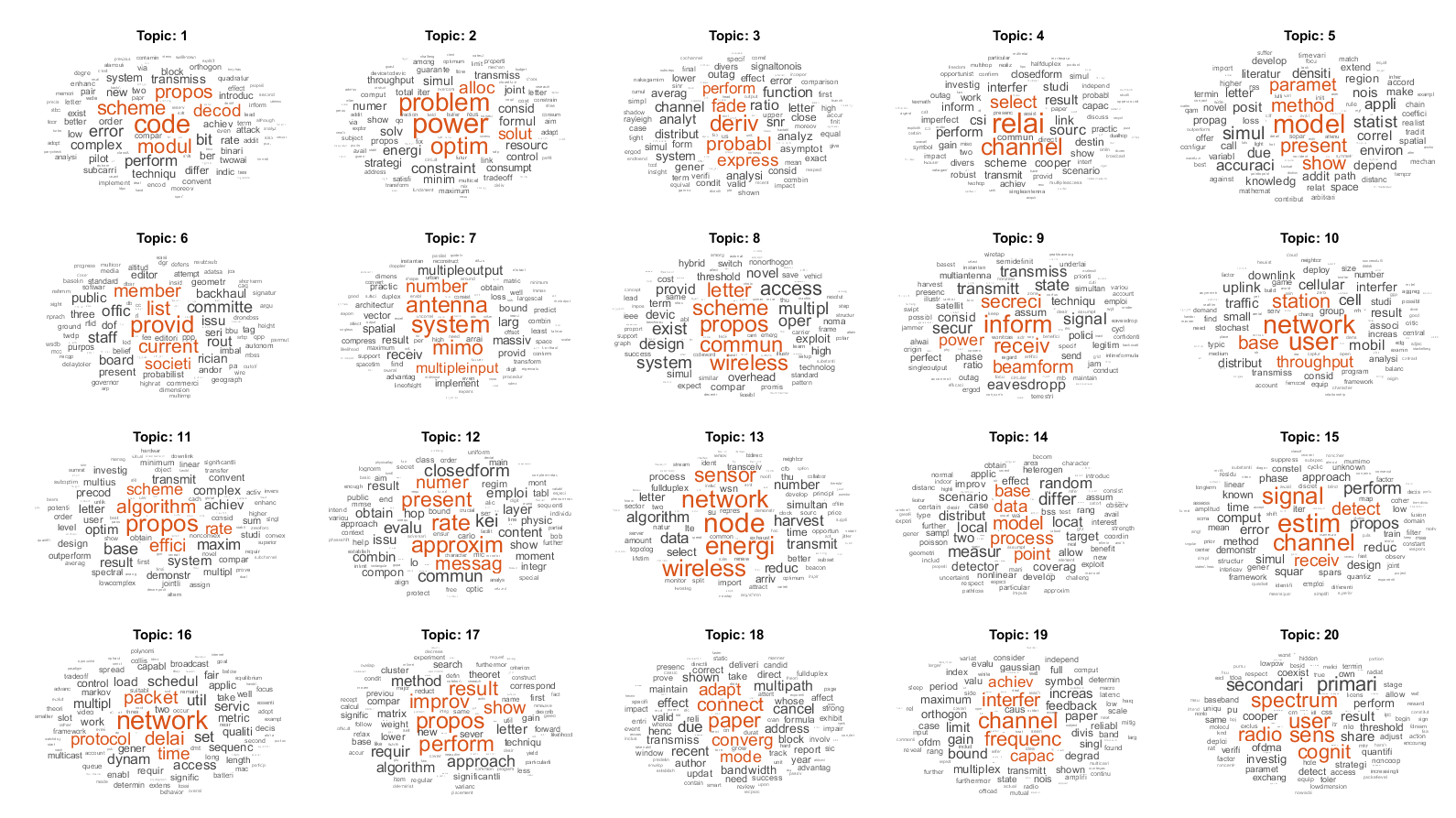
Broader Topic:
IEEE Transactions on Wireless Communications

Slide 39
Topic Estimations
Modulation/coding schemes
Power Optimization
New model proposition
Meta papers (member lists, etc.)
MIMO
Security
New algorithm proposition
Rate estimation
scheme
Sensor/node networks
Throughput/packet delay
Improvements on existing model
Survey Papers
Channel interference

Slide 40
Question #3: Can papers be neatly clustered by subject matter?
Key aspects
Number of topics: smaller is better
Optimum perplexity often way too high
Subject matter is important: broad subject accommodate models better
Human insight is always needed, ambiguous topics
Conclusion? Yes, fairly well

Slide 41
Outline
Introduction
2018 Papers Analysis by LDA and LSA
Model Applicability
TF-IDF Analysis
Perplexity & Insights by Publication
Topic Accuracy
Conclusions and Ending Points

Slide 42
Conclusions
Is this a valuable research tool for you?
Can reveal current research trends
What is this valuable for?
Classifying upcoming papers
Scoring your paper according to current trends

Slide 43
Code
Scripts and plots developed in MATLAB
Code available on my Github
https://github.com/stewythe1st/Research-Mining
IEEE Web API
https://developer.ieee.org/docs

Slide 44
Moving Forward
Figure out a good way to determine optimal number of topics
Try out with documents from other sources
Perhaps perform analysis on paper content, not just abstract

Slide 45
Citations
Research Used
K. S. Jones, “A Statistical Interpretation Of Term Specificity And Its Application In Retrieval”, Journal of Documentation, vol. 28, issue 1, pp. 11-21, 1972
D. M. Blei, A. Y. Ng, and M. I. Jordan, “Latent Dirichlet Allocation,” Journal of Machine Learning Research, vol. 3, pp. 993–1022, Jan. 2003.
S. C. Deerwester, S. T. Dumais, G. W. Furnace, R. A. Harshman, T. K. Landauer, K. E. Lochbaum, and L. A. Streeter, “Computer information retrieval using latent semantic structure ,” 13-Jun-1989.
Works Used in Examples
A. Zanella, N. Bui, A. Castellani, L. Vangelista and M. Zorzi, "Internet of Things for Smart Cities," in IEEE Internet of Things Journal, vol. 1, no. 1, pp. 22-32, Feb. 2014.
Rui Xu and D. Wunsch, "Survey of clustering algorithms," in IEEE Transactions on Neural Networks, vol. 16, no. 3, pp. 645-678, May 2005.
T. Iwata, T. Hirao and N. Ueda, "Topic Models for Unsupervised Cluster Matching," in IEEE Transactions on Knowledge and Data Engineering, vol. 30, no. 4, pp. 786-795, April 1 2018.
K. Wang, H. Gao, X. Xu, J. Jiang and D. Yue, "An Energy-Efficient Reliable Data Transmission Scheme for Complex Environmental Monitoring in Underwater Acoustic Sensor Networks," in IEEE Sensors Journal, vol. 16, no. 11, pp. 4051-4062, June1, 2016.
"IEEE Sensors Journal publication information," in IEEE Sensors Journal, vol. 9, no. 11, pp. C2-C2, Nov. 2009.

Slide 46
Questions?
Questions/Goals
How similar are papers published in journals? More similar than you think!
Can papers be neatly clustered by subject matter? Yes!
Do Journals and Transactions vary more or less than Conference and Workshop Proceedings? Not really
Conclusions
Not much of a valuable research tool for most people
Does reveal current research trends
Is this valuable for…
Classifying upcoming papers
Scoring your paper according to current trends

